Slide 1
Group 2 | TOXIC COMMENTS
Can we use pre-trained models to detect toxic comments?
“yeah ur toxic im slippin under” (Britney Spears, 2003)
20229031 - Nguyen Mai Linh
20229531 - Farhan Toshi Hermawan
21229529 - Fariha Qorinatuz Zahra

Slide 2
Introduction
Hugging Face is a community for learning about and advancing machine learning. One can find many machine learning models, datasets and demo apps on Hugging Face Hub. It’s purpose is to help the community to advance Open, Collaborative, and Responsible Machine Learning. (Hugging Face, n.d.)
“A pre-trained model is a saved network that was previously trained on a large dataset […] You either use the pretrained model as is or use transfer learning to customize this model to a given task” (TensorFlow, n.d.).
Using pretrained models is very Convenient and Time-saving. There is no need to build a model from scratch, thus making the data processing and analyzing much faster (Baeldung, March 2023).

Slide 3
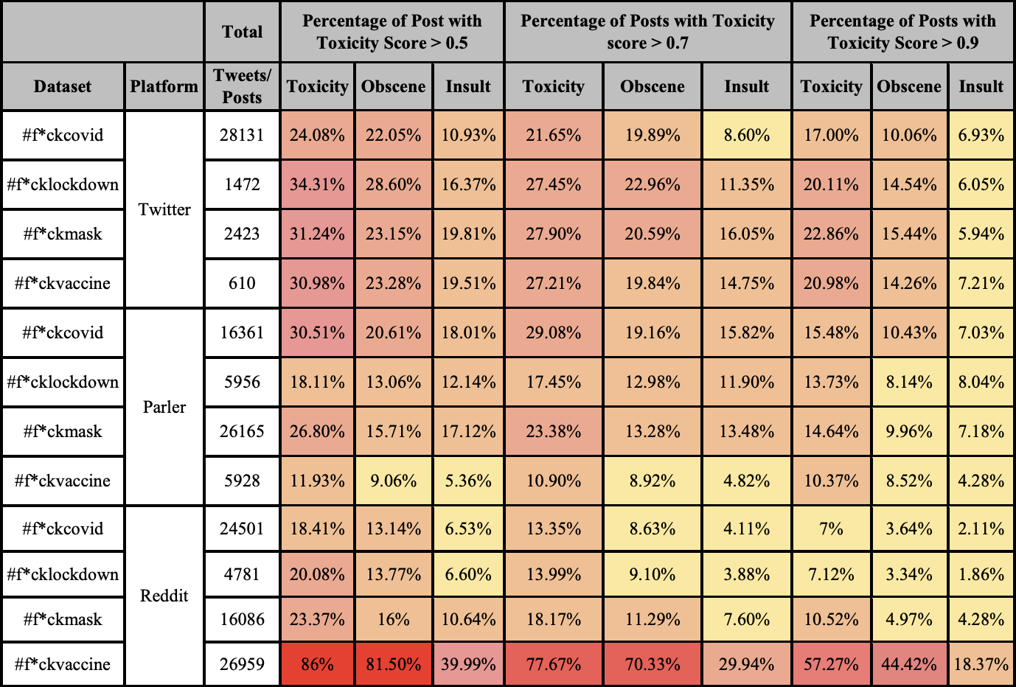
Problem & Motivation
Social Platforms have become a platform for people to express their opinions and engage in discussions.
Those social platforms’ data especially in text form can include hate speech, personal attacks, and toxicity.
Showcase the model that are designed to counter these toxic comments, which later can be applied in those platforms to make a more positive online environment (if needed).

Slide 4
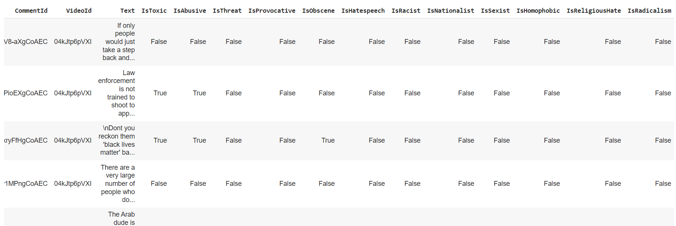
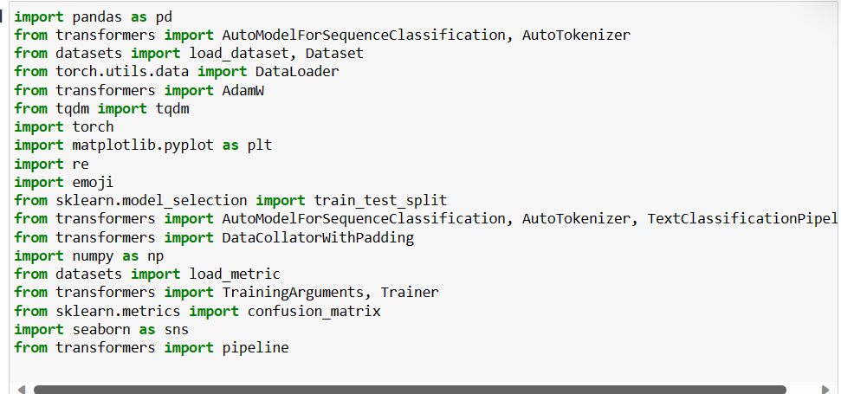
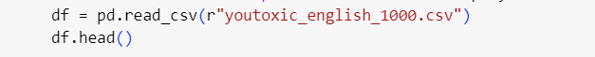
Data & Preprocessing
Youtube comment dataset from Kaggle on Ferguson Unrest; involving government and police aspects
Import libraries & Print dataset

Slide 5
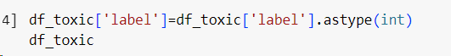
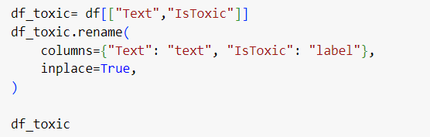
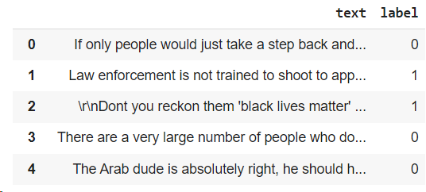
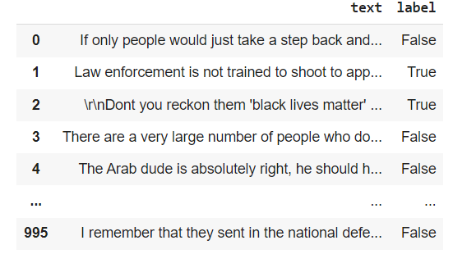
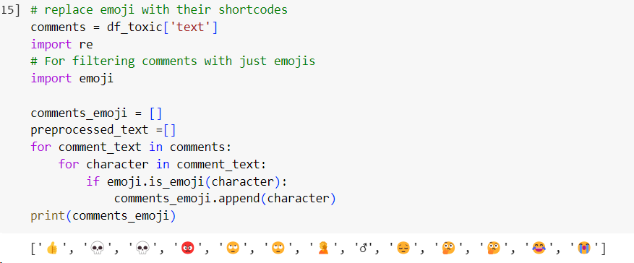
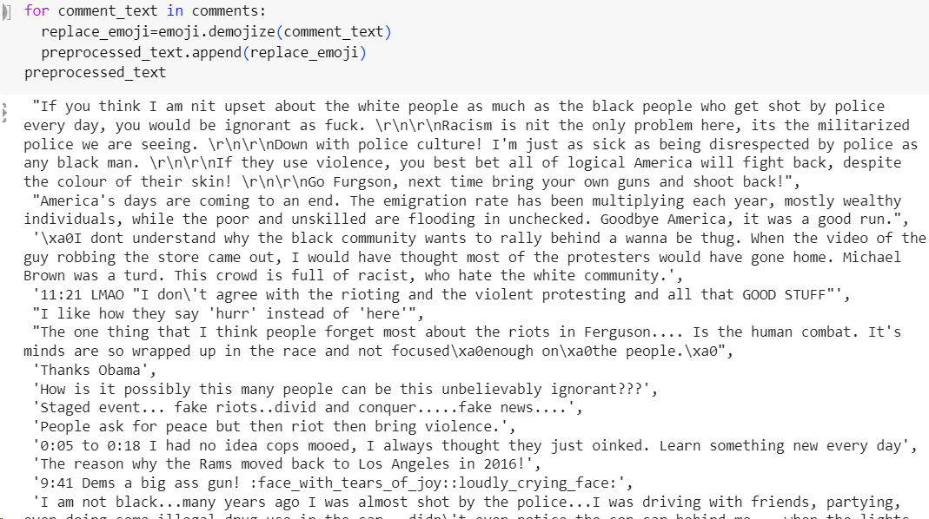
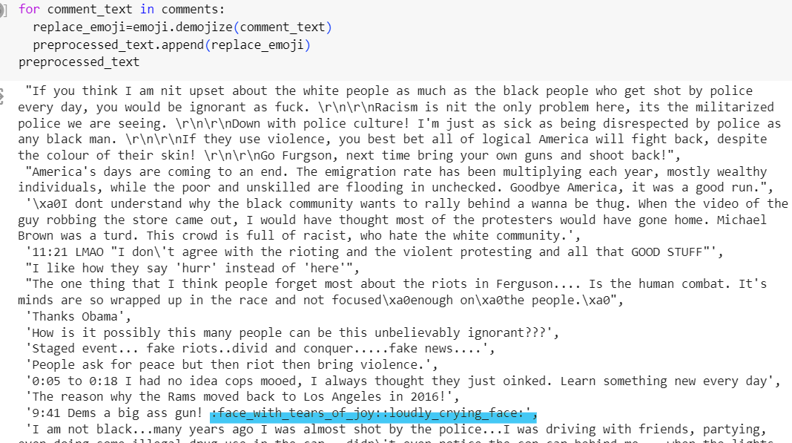
Take only necessary columns
Change to label to integer
Replace emoji with shortcodes
See if data has emojis

Slide 6
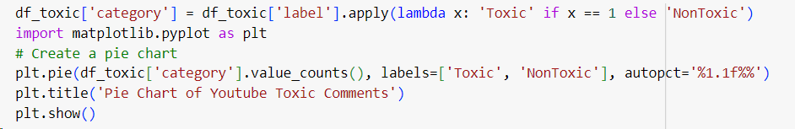
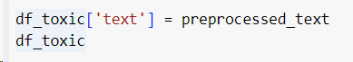
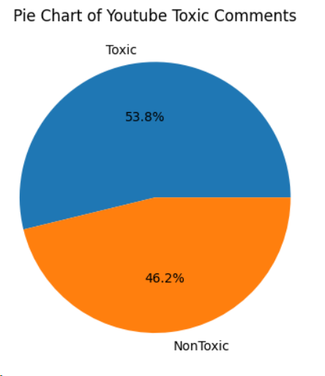
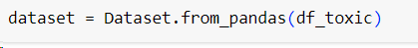
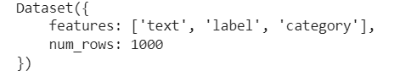
Lets see the distribution of the dataset!
Replace comments with the preprocessed version
Input it as our dataset

Slide 7


Model Selection: DistilBERT-base-uncased
DistilBERT itself: well-regarded model in the Transformers library, suitable for sentiment analysis and easy to use.
Installed 10 million times on Hugging Face.
Distilled from the BERT model, thus smaller and faster. It can “reduce the size of a BERT model by 40%, while retaining 97% of its language understanding capabilities and being 60% faster” (Sanh et al., 2019).
Intended for masked language modeling or next sentence prediction, but mostly intended to be fine-tuned on a downstream task.

Slide 8
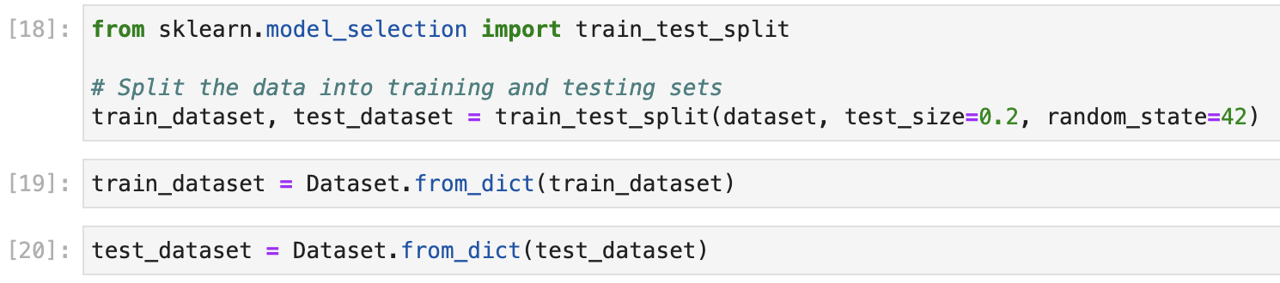
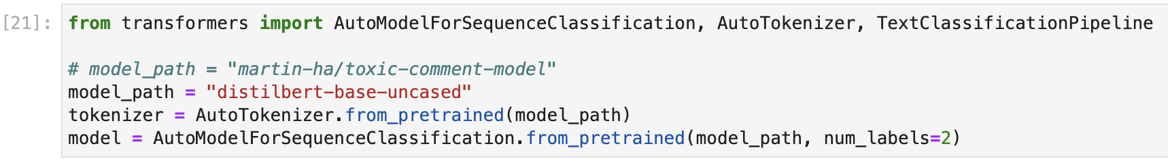
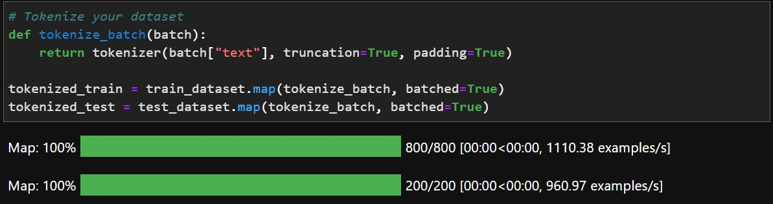
Model Training and Testing

Slide 9
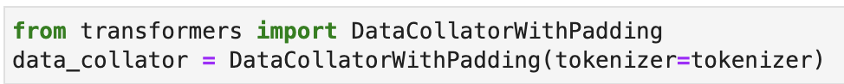
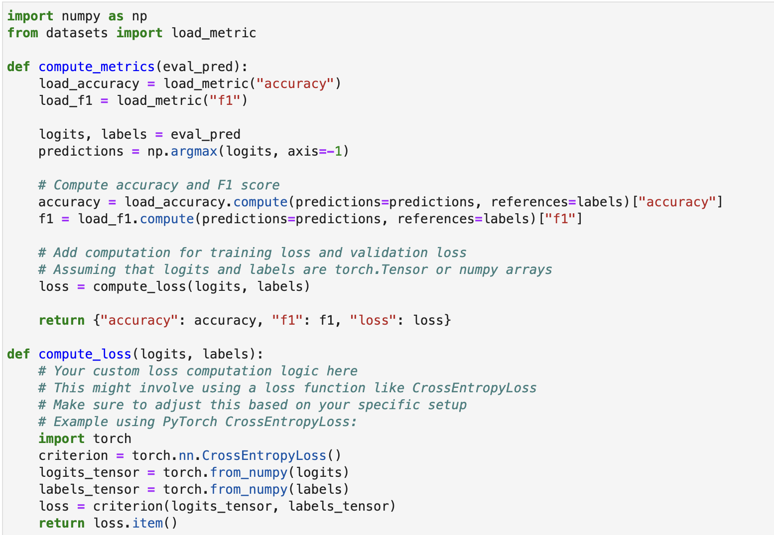
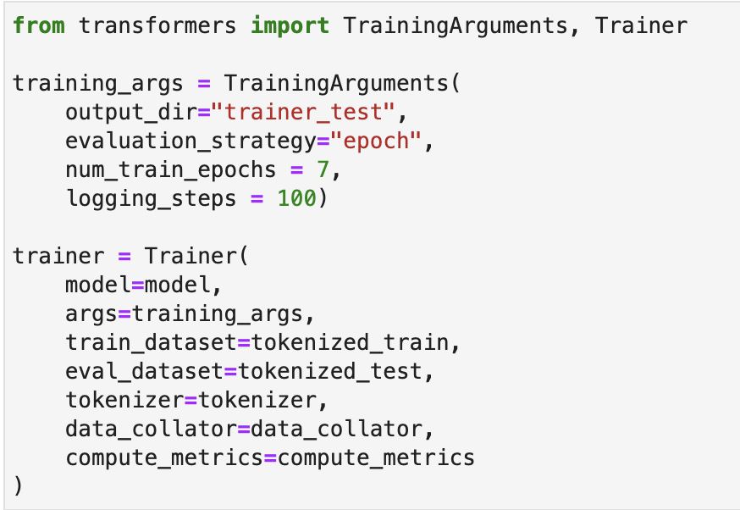
Model Training and Testing

Slide 10


Slide 11
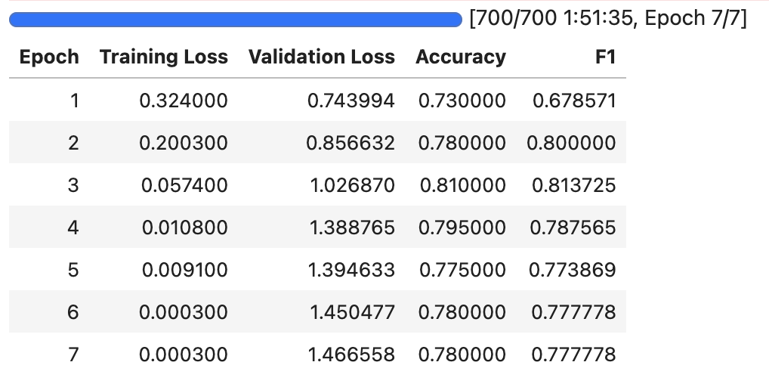
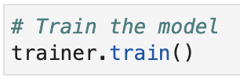
Training Results
Training with 7 Epoch, we found that the training loss steadily drops while the validation loss rises, and that the rate of change for both decreases over time.

Slide 12
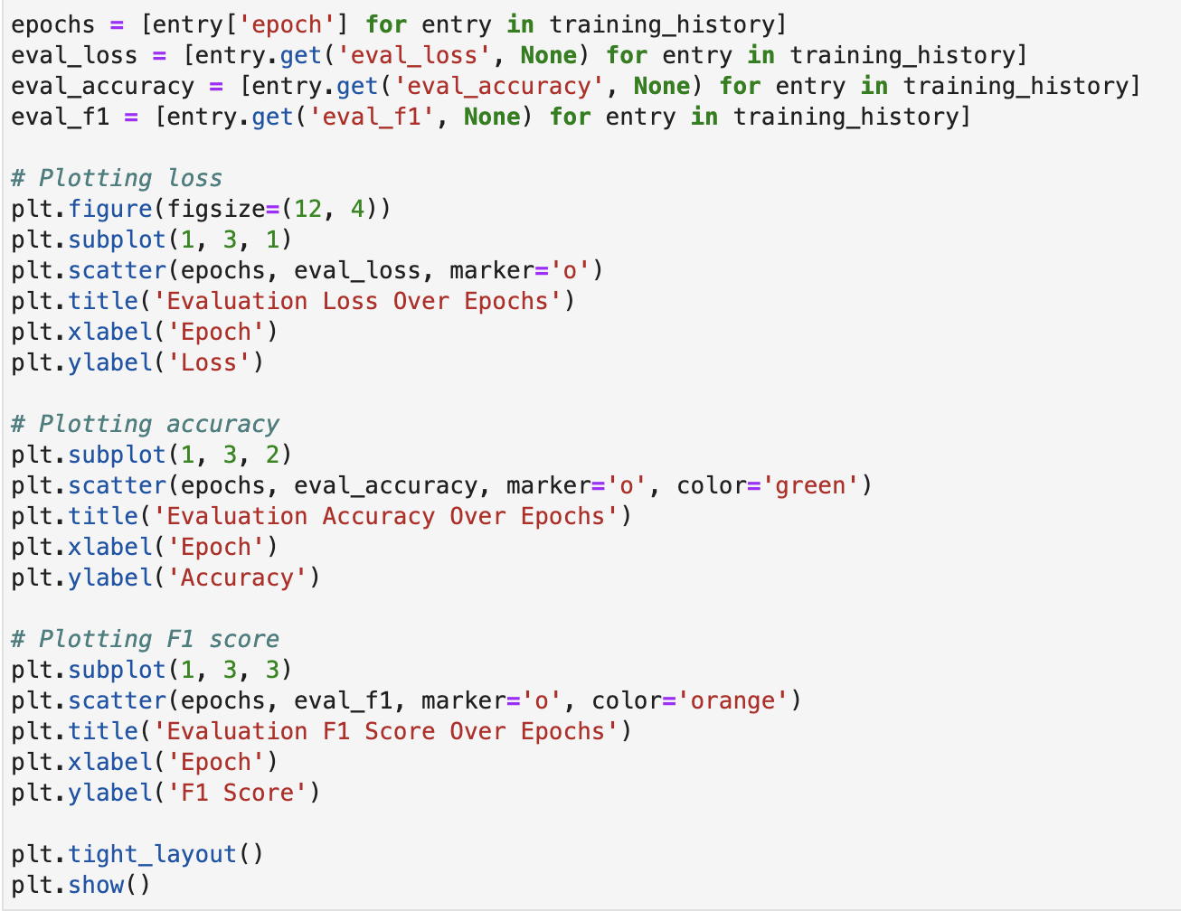
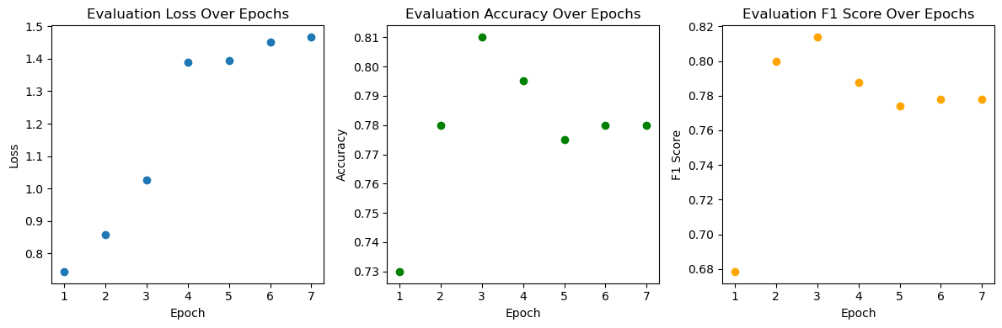
Model Evaluation

Slide 13
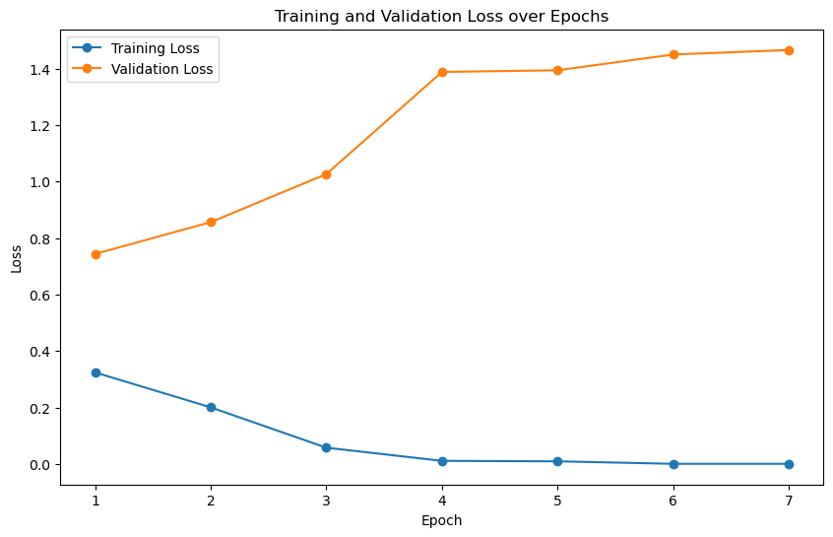
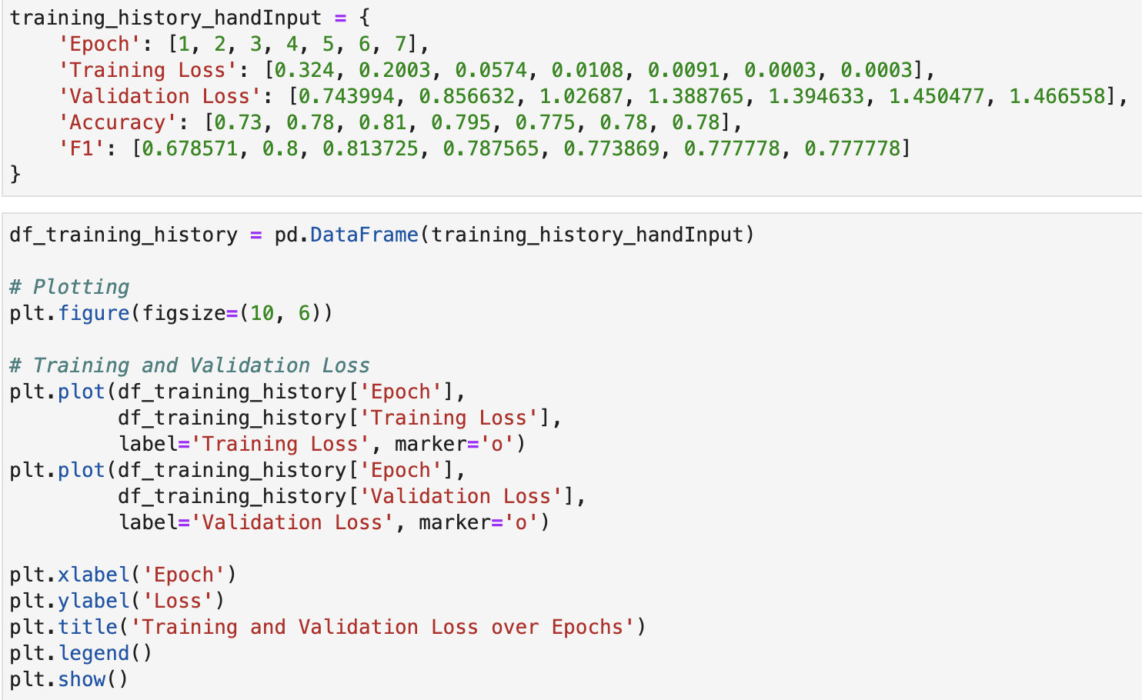
Training & Validation Loss

Slide 14
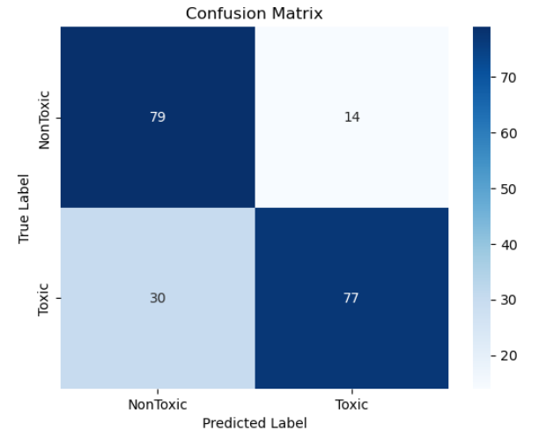
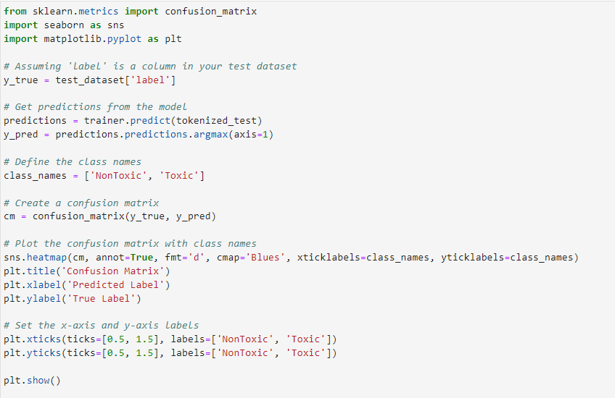
Confusion Matrix

Slide 15
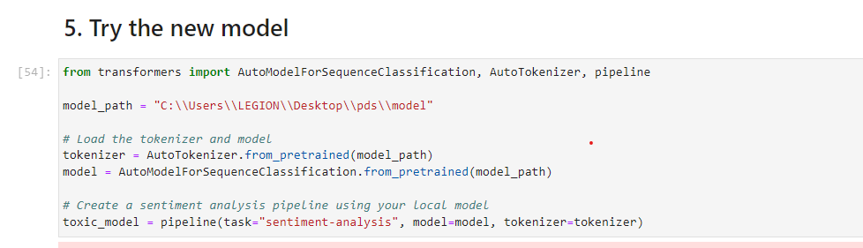
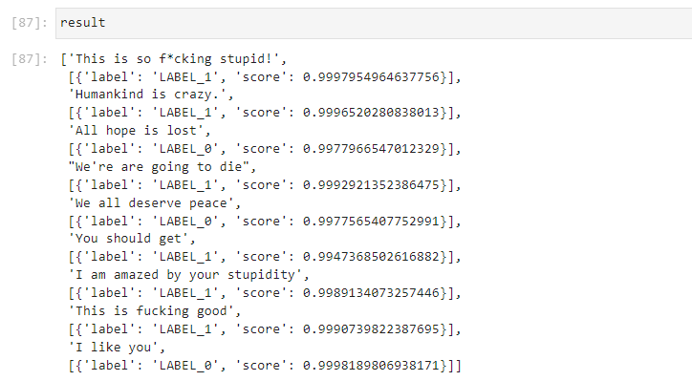
Sentiment Analysis on the Model
When tested with our own comments; inputs that contains slightly negative words are marked as toxic.
LABEL_1: Toxic
LABEL_2: Non toxic

Slide 16
Results and Discussion
The model can detect toxicity in text with accuracy around 80%.
Might not accurately predict data outside the dataset, as overfitting occured (higher validation loss than training loss).
There is limitation due to context dependency, language development and subjectivity.
To improve, use larger dataset, add more parameters, and use a better hardware for a faster and more effective process.

Slide 17
Conclusion & Future Work
Ethics and Limitation
Because it scraped out people’s opinion, it might be harmful to privacy and safety, as well as is inevitable to bias.
Capacity of the model is limited due to context dependency, language development and subjectivity.
It cannot do a more complex concept like sarcasm
Checking unintended bias in the trained model
Using Receiver Operating Characteristic (ROC) and F1-Score (Settipalli & Dasireddy, 2021)
Multi-labelled classification
Specify labels. eg. threat, insult, hate crime
Someone did this with DistilBERT model

Slide 18
References
https://www.kaggle.com/datasets/reihanenamdari/youtube-toxicity-data/data
https://huggingface.co/distilbert-base-uncased-finetuned-sst-2-english
https://huggingface.co/docs/transformers/v4.15.0/training
https://colab.research.google.com/drive/1t-NJadXsPTDT6EWIR0PRzpn5o8oMHzp3?usp=sharing#scrollTo=oB-ikgCN77wP
https://colab.research.google.com/github/nkthiebaut/nkthiebaut.github.io/blob/source/content/toxic_comments_transformer.ipynb
https://www.diva-portal.org/smash/get/diva2:1534152/FULLTEXT02.pdf
https://arxiv.org/pdf/2302.14270.pdf
https://www.baeldung.com/cs/neural-network-pre-training#:~:text=Furthermore%2C%20pre%2Dtrained%20models%20have,require%20lesser%20data%20to%20converge.
https://www.tensorflow.org/tutorials/images/transfer_learning
https://huggingface.co/docs/hub/index#whats-the-hugging-face-hub
https://arxiv.org/abs/1910.01108

